Slide 1
Pre-Calc & Trig
Day 44

Slide 2

Bell Work
Prove:
$$\frac{1+\sin{x}}{\cos{x}}+\frac{\cos{x}}{1+\sin{x}}=2sec{x}$$

Slide 3
From Last Time
Day 1: Pg 377 #5, 6, 13, 14, 25–31 (odd), 79, 123
Day 2: Pg 377 #41–49 (odd), 125

Slide 4
5.2 Verifying IDs
Objective: Verify (prove) trigonometric identities

Slide 5

Review from Last Time: Perform the addition and simplify: $$\frac{\sin{t}}{1+\cos{t}}+\frac{\cos{t}}{\sin{t}}$$

Slide 6
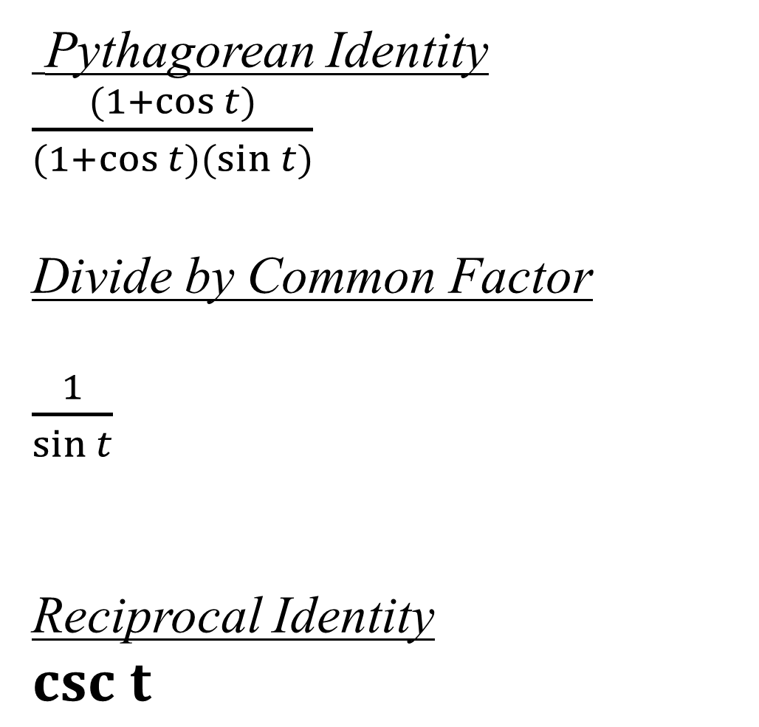
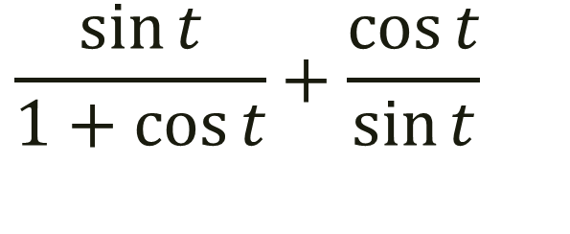
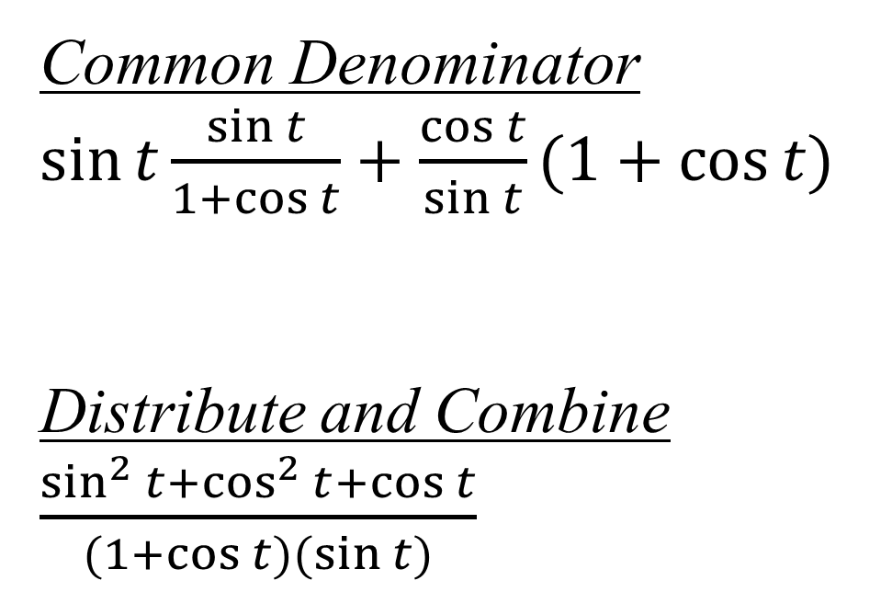
$$\frac{\sin{t}}{1+\cos{t}}+\frac{\cos{t}}{\sin{t}}$$
Pythagorean Identity
$\frac{(1+\cos{t})}{(1+\cos{t)(\sin{t)}}}$
Divide by Common Factor
$\frac{1}{\sin{t}}$
Reciprocal Identity
$csc t$
Common Denominator
$\sin{t}\frac{\sin{t}}{1+\cos{t}}+\frac{\cos{t}}{\sin{t}}(1+\cos{t)}$
Distribute and Combine
$\frac{sin^{2}{t}+cos^{2}{t}+\cos{t}}{(1+\cos{t)(\sin{t)}}}$

Slide 7
Guidelines to Verifying Trig Identities
1.) Work on ones side of equation at a time. Often it is best to work with the ‘more complicated’ side first. (You can not add an expression to both sides, or cross multiply because you don’t know that they are equal yet).
2.) Look for opportunities to factor an expression, add fractions, square a binomial, or create a monomial denominator.
3.) Look for opportunities to use the fundamental identities. (Make note of which functions are in final expression you want). Sines and cosines pair up well, as do secants and tangents, cosecants and cotangents.
4.) If the first 3 Guidelines don’t work, try converting all terms to sine and cosine.
5.) Always try something. Dead ends can provide insight.

Slide 8

Verify: $\sec{x\cot{x=\csc{x}}}$

Slide 9

Verify: $\sec{x\cot{x=\csc{x}}}$
$$\frac{1}{\cos{x}}\frac{\cos{x}}{\sin{x}}=?\csc{x}→\frac{1}{\sin{x}}=\csc{x}$$

Slide 10

Verify: $\cos{x−\cos{x sin^{2}x=\cos^{3}x}}$

Slide 11

Verify: $\cos{x−\cos{x sin^{2}x=\cos^{3}x}}$
$$\cos{x(1−sin^{2}x)=\cos^{3}x}$$
$$\cos{x(cos^{2}x)=\cos^{3}x}$$

Slide 12

Verify: $\frac{\sin{x}}{1+\cos{x}}=\frac{1−\cos{x}}{\sin{x}}$

Slide 13
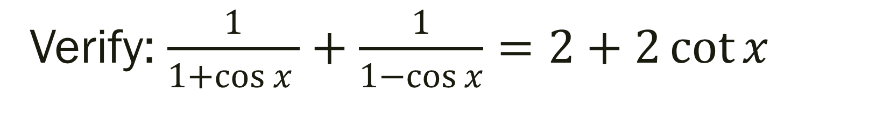
Verify: $\frac{1}{1+\cos{x} }+\frac{1}{1−\cos{x}}=2+2\cot{x}$

Slide 14
For Next Time
Day 1: Pg 385 #3-8, 9-13 (odd), 17, 19, 23
Day 2: Pg 385 #10-20 (even), 25, 29, 31

